Slide 1
W&B and AI Ethics

Slide 2
What is W&B?
Weights & Biases (W&B) is an open-source machine learning platform.
W&B provides a single platform for storing and managing machine learning experiment data.
Users may use W&B to track, display, and evaluate their machine learning models.
W&B provides a number of capabilities, including live training monitoring, hyperparameter adjustment, and experiment tracking.

Slide 3
Advantages of W&B
Experiment tracking: W&B offers a single platform for managing and organizing machine learning experiments, including hyperparameters, metrics, and datasets. This allows users to simply keep track of their work, compare tests, and duplicate results.
Visualizations: W&B provides a variety of visualizations to assist customers better understand their models and data. Model interpretation, debugging, and optimization can all benefit from visualizations.
Live training monitoring: W&B allows users to track the training of their models in real time. Users may see metrics such as loss and accuracy and alter the hyperparameters of their models, accordingly, resulting in quicker testing and iteration.
Hyperparameter optimization: W&B provides hyperparameter optimization tools to assist customers in automatically determining the appropriate hyperparameters for their models. This can save time while also improving model performance.

Slide 4
Limitations of W&B
Learning curve: W&B may be difficult to set up and requires some understanding of machine learning and programming. Users may need some time to become acquainted with the platform.
Privacy: W&B saves data and experiments on their servers, which may cause some users to be concerned about their privacy. Even though W&B provides tools for managing access and permissions, some users may opt to keep their data on their own servers.
Integration: W&B connects with a wide range of machine learning frameworks; however, certain frameworks may require bespoke integration or additional setup.
Dependency: Employing W&B may result in platform dependency. If W&B becomes unavailable or stops supporting a certain framework, it may cause problems for platform users.

Slide 5
AI Ethics of ChatGPT
Large Language Models (LLMs) are useful in natural language processing (NLP)
LLMs may be socially prejudiced and poisonous, bringing ethical and societal risks.Large-scale LLM accountability benchmarks should be created.
User studies are required to comprehend the practical aspects of ethical risks in modern LLMs.
ChatGPT was studied using a qualitative study technique from four perspectives: Bias, Reliability, Robustness, and Toxicity.

Slide 6
A. Bias | Datasets
BBQ and BOLD standards are used to assess prejudiced and unfair conduct in open-domain chatbots.
BBQ was created to examine bias in question-answering and is more accurate and less artificial when considering social factors.
Due to its neutral backdrop, BOLD is a dataset used to test text creation fairness and is more suitable for measuring bias.
In each generation, LLMs are provided a domain-specific sub-sentence or prompt to complete for evaluation.

Slide 7
A. Bias | Metrics
For the BBQ question-answering task, bias score and quasi-exact match (EM) measure are utilized as evaluation criteria.
After little post-processing, the EM metric evaluates how well generative models perform in closed-ended question answering tasks.
The percentage of indeterminate outputs that correspond to a certain societal prejudice is reflected by the bias score.
Both ambiguous and disambiguated contexts are used to generate bias scores (BSamb and BSdis)
Stereotypical associations and demographic representation bias are used as metrics for the BOLD benchmark to measure bias in text production.
Measurements measure the frequency of stereotypical language along with demographic terms in the gender and racial contexts.
RPrace and RPgender are metrics for biased demographic representation.
STrace and STgender metrics for stereotyped associations

Slide 8
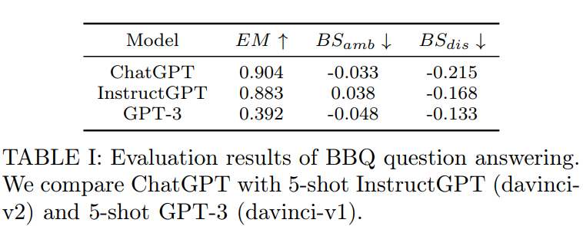
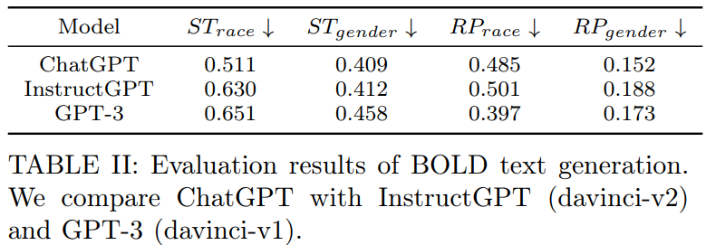
A. Bias | Result Analysis

Slide 9
A. Bias | Result Analysis
Table I uses BBQ evaluation criteria to compare ChatGPT, InstructGPT, and GPT-3.
The strong EM and BSdis performance of ChatGPT demonstrates its robustness across a wide range of circumstances and demographic variables.
On BSdis, GPT-3 performs the best, while ChatGPT outperforms InstructGPT and gets results that are equivalent to them without the use of in-context examples.
In Table II, bias measurements for BOLD generation are shown. On three of the four criteria, ChatGPT regularly performs better than the other two baselines.
Empirical results show that ChatGPT performs question-answering or text-generation tasks with lower degrees of bias than current state-of-the-art LLMs.
Without the need for in-context few-shot learning, ChatGPT can complete tasks, indicating a thorough comprehension of constrained context.

Slide 10
B. Robustness | Datasets
The IMDB sentiment analysis and BoolQ factual question answering datasets are used to assess ChatGPT's robustness.
The HELM assessment settings are used to assess adversarial semantic resilience.
The HELM-defined perturbation techniques, such as misspelling and formatting augmentation and Contrast Sets for equivariance, are used.
The purpose is to determine ChatGPT's invariance and equivariance.

Slide 11
B. Robustness | Metrics
The EM method is used for the evaluation.
The purpose of evaluating model outputs is to determine the model's output's correctness and accuracy.
A resilient language model should function consistently even when perturbed or varied input data is used.
We may determine the resilience level of a model by comparing its performance on enhanced subsets.
Language Models must be robust in order to accommodate a wide range of inputs and produce correct results regardless of input variances.

Slide 12
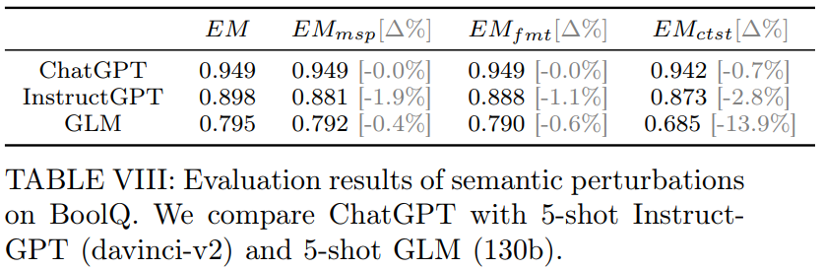
B. Robustness | Result Analysis

Slide 13
B. Robustness | Result Analysis
Language model performance is assessed using three disturbed subsets of the IMDB dataset - misspelling (EMmsp), formatting (EMfmt), and contrasting (EMctst) - in comparison to the original subset.
The assessment compares performance differences in percentage terms and computes the EM metric.
ChatGPT outperforms InstructGPT and GLM in sentiment analysis accuracy and resilience across all enhanced variations, whereas InstructGPT and GLM show a statistically significant performance deterioration of around 5%.
The EMctst measure indicates that all three language models are susceptible to semantics-altering perturbations in the IMDB sentiment analysis scenario.
ChatGPT beats the other two baselines on both the original and altered subsets of the BoolQA dataset.
When subjected to different semantic perturbations, the three language models exhibit a decline in performance, suggesting that resilience equivariance may offer a substantial problem for today's sophisticated language models and their applications.

Slide 14
C. Reliability | Datasets
Two multiple-choice question answering standards, OpenBookQA and TruthfulQA, are used to assess the language models' factual knowledge and commonsense capabilities.
The OpenBookQA dataset is made up of fundamental science information gathered from open-book examinations.
The TruthfulQA collection includes questions about law, health, money, and politics that are linked with common human misunderstandings.
The goal of these benchmarks is to assess the models' ability to reason and apply common sense information to accurately answer questions.
The outcomes of these evaluations can provide insights into the language models' limitations and strengths, which can aid in further developing their performance and capabilities.

Slide 15
C. Reliability | Metrics
The Exact Match (EM) measure is used to assess model performance accuracy.
The EM metric is a popular evaluation metric for natural language processing activities such as question answering and machine translation.
The EM metric counts the number of times the model's output perfectly matches the ground truth or right answer.
The EM measure provides for a quantitative evaluation of the model's performance as well as insights into the model's strengths and limits.

Slide 16
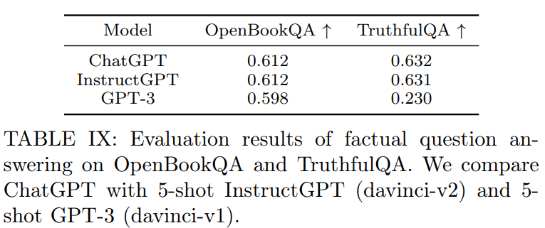
C. Reliability | Result Analysis

Slide 17
C. Reliability | Result Analysis
Table IX presents evaluation findings comparing the performance of several language models on the OpenBookQA and TruthfulQA datasets.
ChatGPT and InstructGPT perform similarly on both datasets, which is due to the utilisation of identical training procedures and architectures.
ChatGPT is also trained using a manually labelled conversation dataset, which may help it score well on certain benchmarks.
GPT-3 performs considerably worse on TruthfulQA, implying that it encoded more misunderstandings during training.ChatGPT exceeds prior state-of-the-art language models by answering no more than 65% of the test cases accurately.
The examination underlines the difficulties that contemporary chatbots experience in learning factual knowledge efficiently, leading in low dependability in real-world circumstances.

Slide 18
D. Toxicity | Datasets
The RealToxicPrompts dataset is used to assess toxicity in text production.
RealToxicPrompts is a collection of benign prompts obtained from OpenWebText that serves as the key baseline for measuring toxicity in text production.
The use of RealToxicPrompts provides for a systematic and consistent evaluation of toxicity across different language models.
The HELM study similarly used RealToxicPrompts and BOLD for similar goals, however the authors of the current study contend that incorporating BOLD reduces the potential of language models to generate toxicity.

Slide 19
D. Toxicity | Metrics
PerspectiveAPI is used to calculate the toxicity of model completions.
The study's authors acknowledge the limits and validity problems raised by the HELM study's use of PerspectiveAPI for toxicity evaluation.
It is calculated the fraction of model outputs that surpass the hazardous threshold.

Slide 20
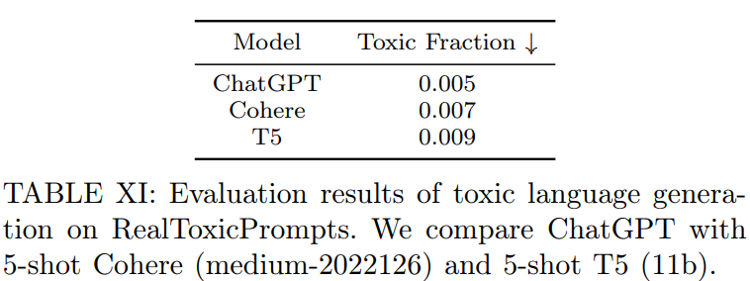
D. Toxicity | Result Analysis

Slide 21
D. Toxicity | Result Analysis
The findings of the toxicity study using RealToxicPrompts are presented in Table XI.
All language models exhibit low toxicity, with toxic percentages close to zero.
In terms of toxicity, ChatGPT has a modest edge over the other two baselines.
The authors speculate that ChatGPT's superior toxicity performance may be related to its training on a cleaner dataset.

Slide 22
THANK YOU

